Slide 1

RFID based online monitoring attendance system
END SEM EVALUATION PRESENTATION
Aman Ranjan Verma | Saurabh kumar | Sumit kumar
Dept. of Electronics and Communication Engineering, IIIT Manipur

Slide 2


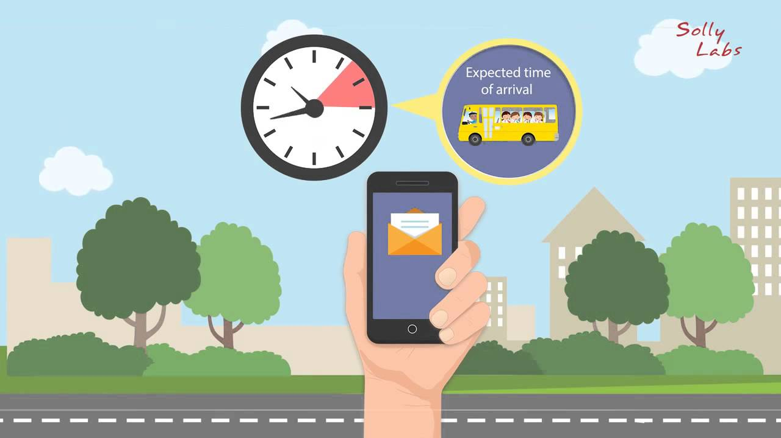
Introduction :
Radio Frequency Identification based attendance system is an automatic attendance system which consists of a micro controller, RFID reader, RFID tag and a data base(firebase) as its primary components.

Slide 3
Motivation behind the project
Roll call in educational institutions and offices consumes considerable amount of time and resources.
Schools can overcome this inefficiency and address the problem adopting RFID based attendance.
Though this traditional attendance management is still popular in many of schools, the concept of the use of RFID based attendance system is gradually gaining momentum in city schools.
Child Safety is very important nowadays and everyone wants to get information from the school about their child attendance in the school.

Slide 4
Problems of existing attendance systems
Earlier attendance system is based on GSM module.
The setup cost and operating cost of these systems are more.
What’s new in our attendance system ?
Since, it uses Wi-Fi module for data transmission, it’s operational cost is almost zero.
Highly customizable
Highly scalable
Dedicated android application to keep track of the attendance record.
Graphical Display
It uses counters to avoid proxy.

Slide 5
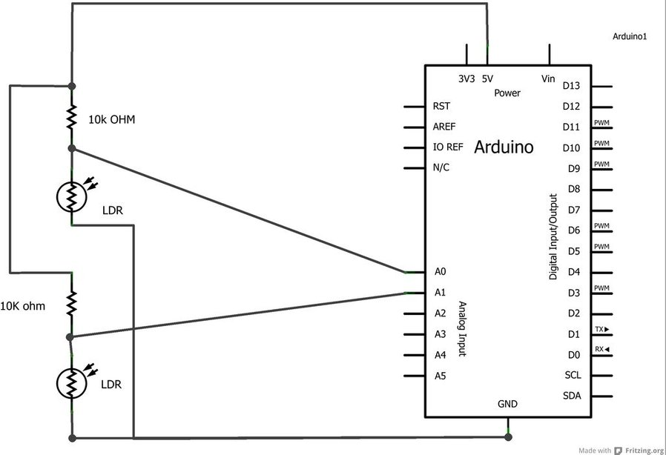
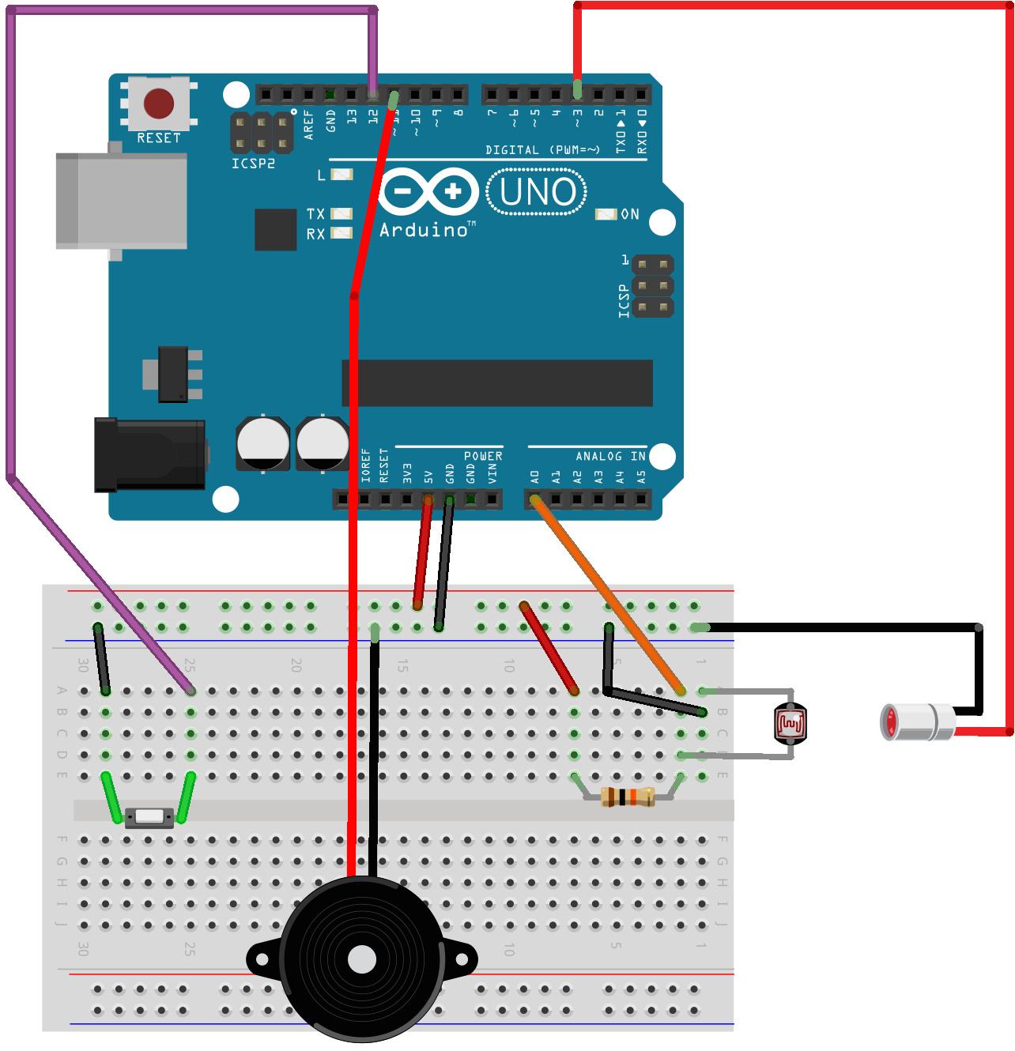
Started with Bidirectional counter

Slide 6
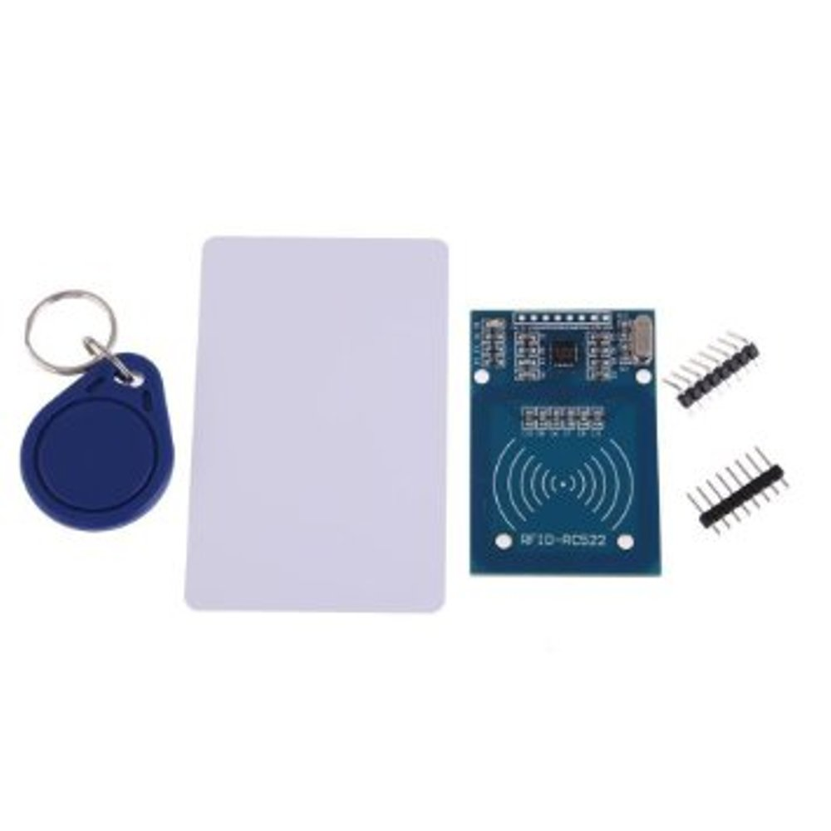
Started with …
Earlier we started with MFRC522 which works on 13.5 MHz frequency.
But since our card works on 125 KHz, we had to switch to EM18 RFID module.

Slide 7
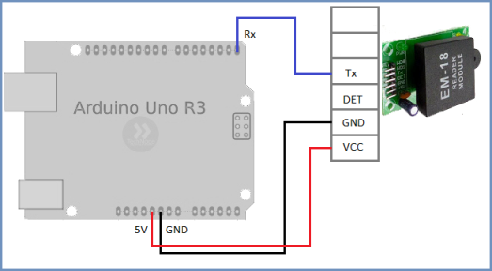
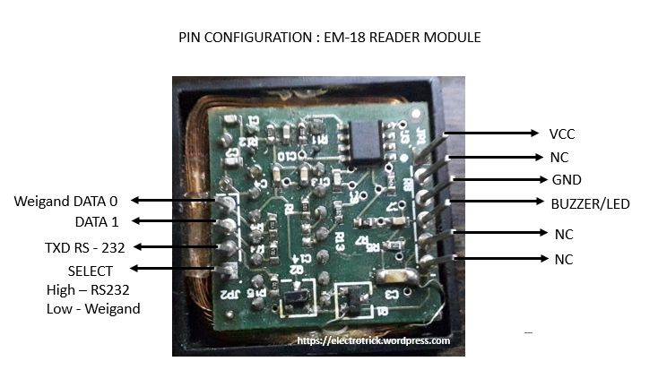
EM18 RFID READER MODULE

Slide 8
Working principle
As the RFID Reader is sending a radio waves of a particular frequency so the voltage that is induced across the coil is also of a particular frequency.
The magnetic field generated by RFID module induces current in RFID tag. This is called as inductive coupling.
According to the data that is stored inside this RFID Tag then that data can be read by the RFID Reader in the form of a voltage. So, in this way the data is sent back to the RFID Reader.
Further Arduino will receive the data and process it.

Slide 9
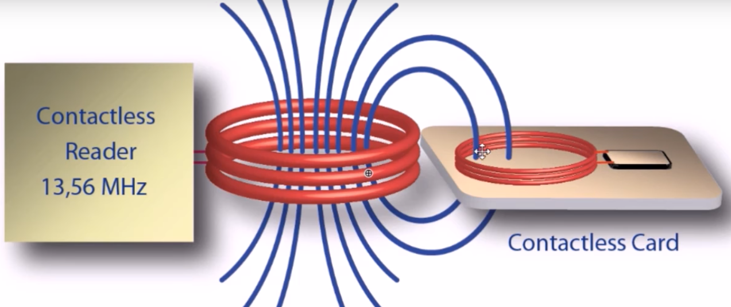
Working principle cont …
125 KHz

Slide 10
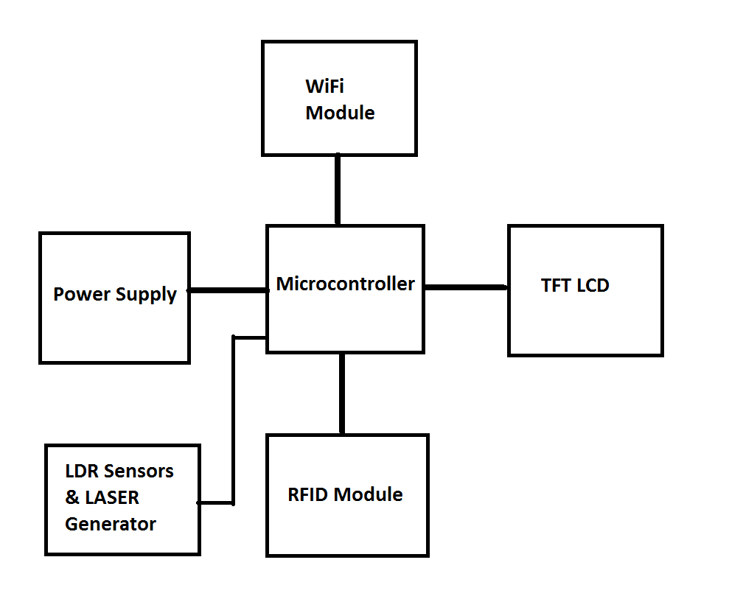
Interfacing

Slide 11
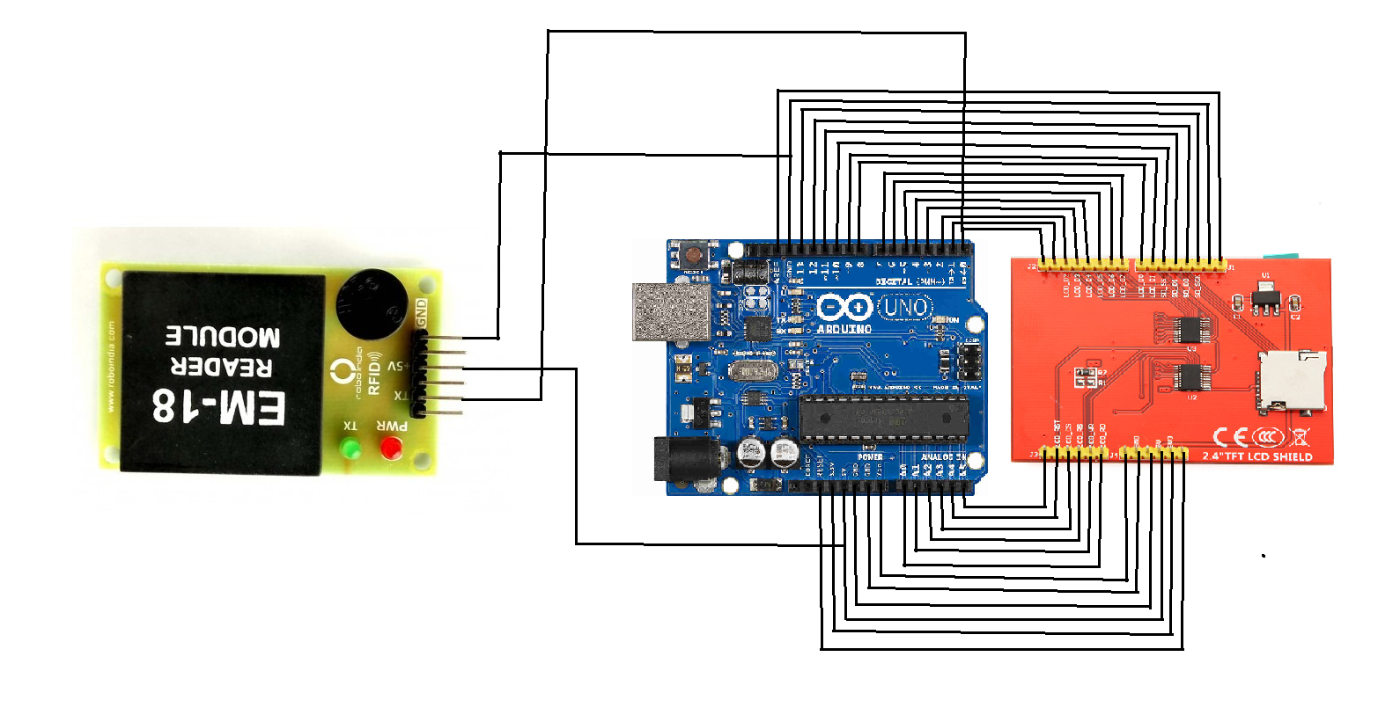
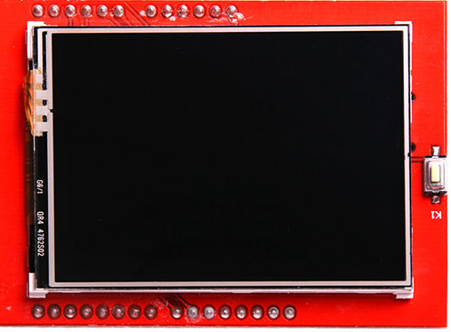
Interfacing
Arduino – LCD

Slide 12
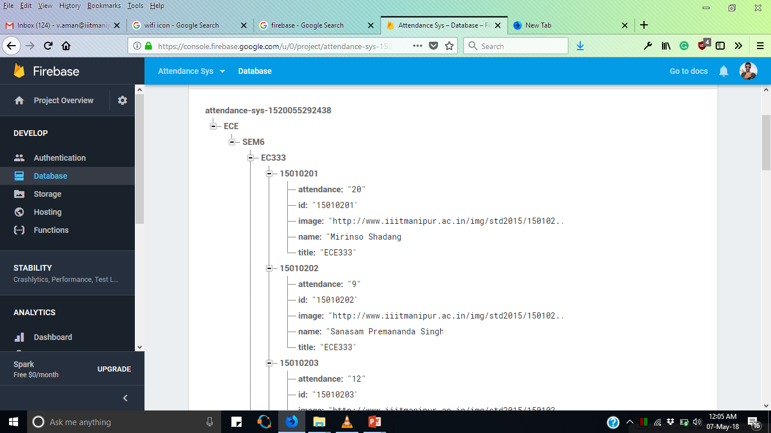
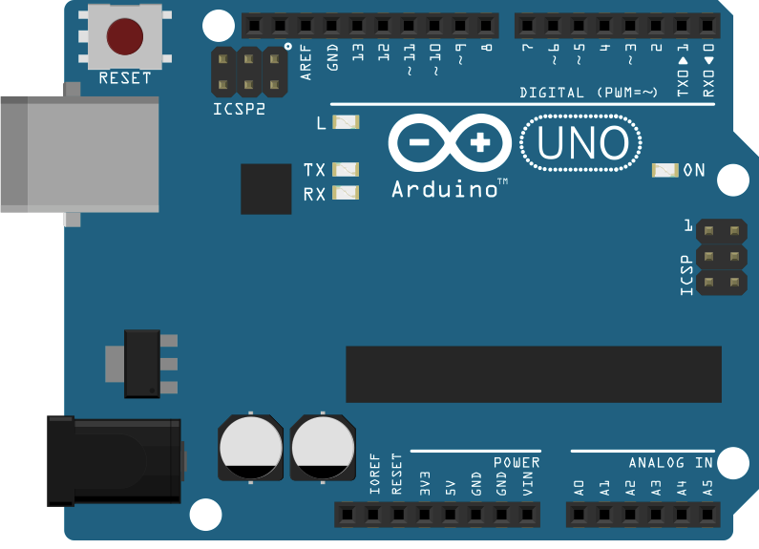
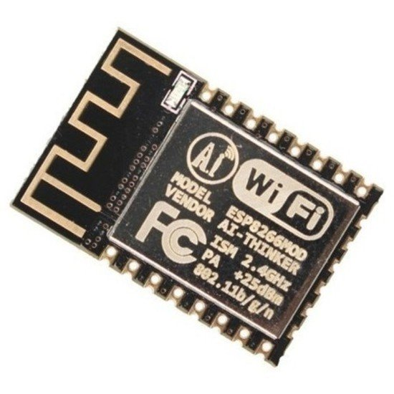
Interfacing cont ..
Arduino --> Wi-Fi --> Firebase

Slide 13
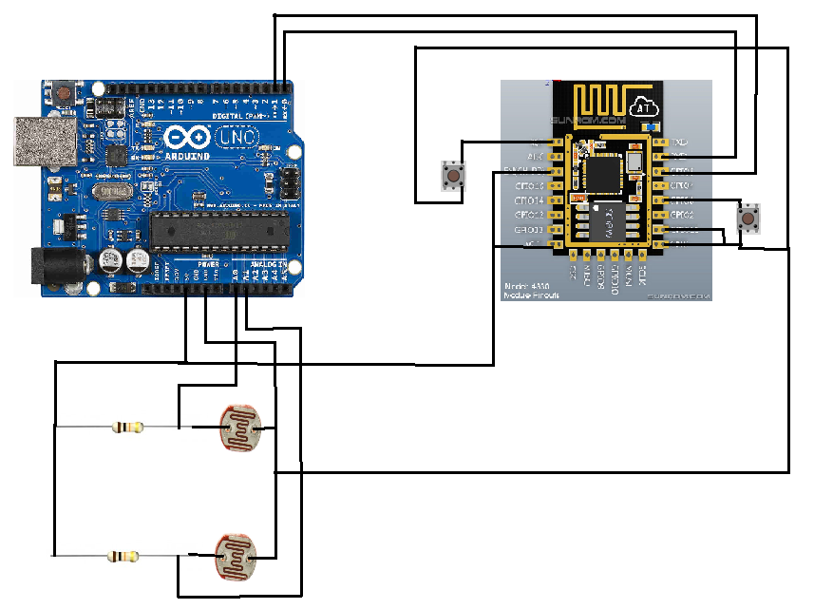
Arduino + Wi-Fi + Firebase

Slide 14
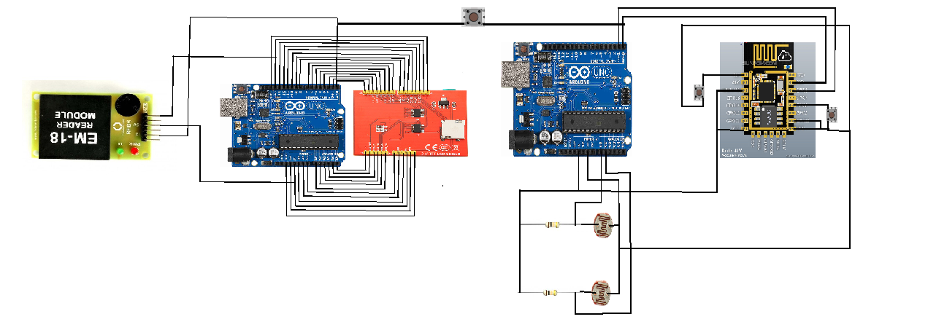
Complete Circuit Diagram

Slide 15

Android Application
IOT Based attendance system

Slide 16
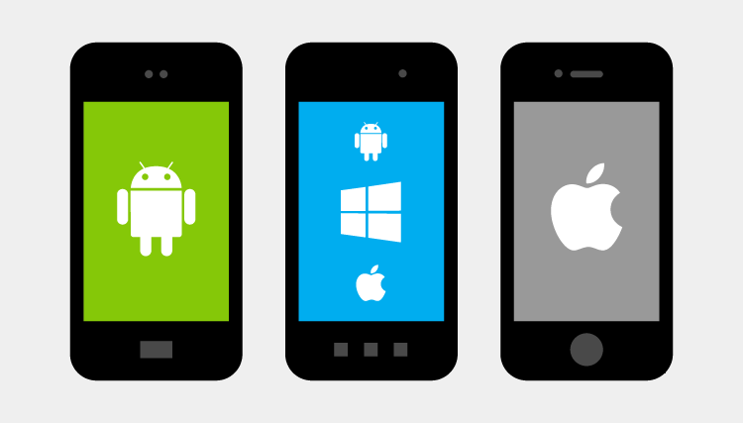
Android
Android is a mobile operating system developed by Google, based on a modified version of the Linux kernel and other open source software and designed primarily for touchscreen mobile devices such as smartphones and tablets.

Slide 17

Android App

Slide 18
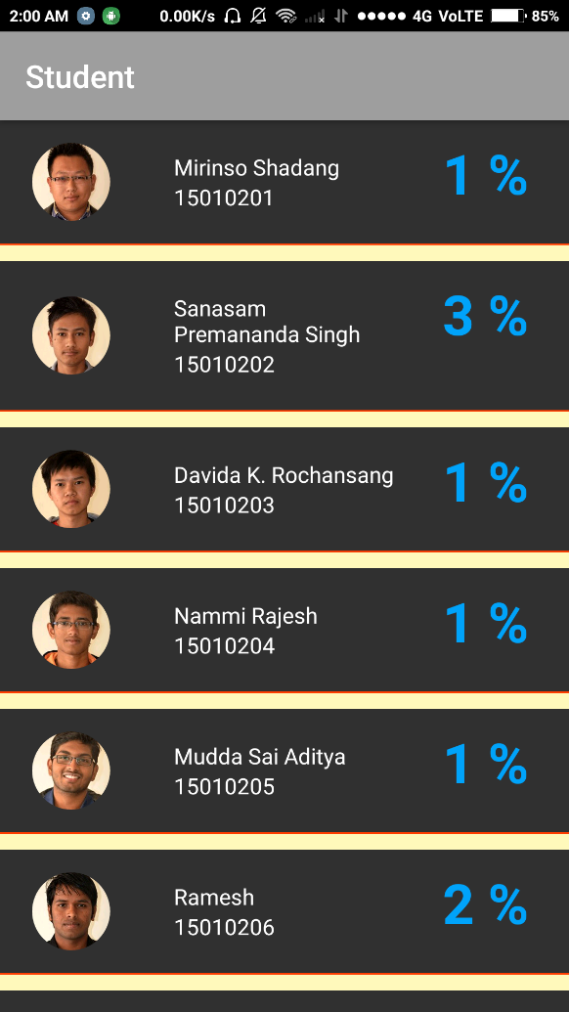
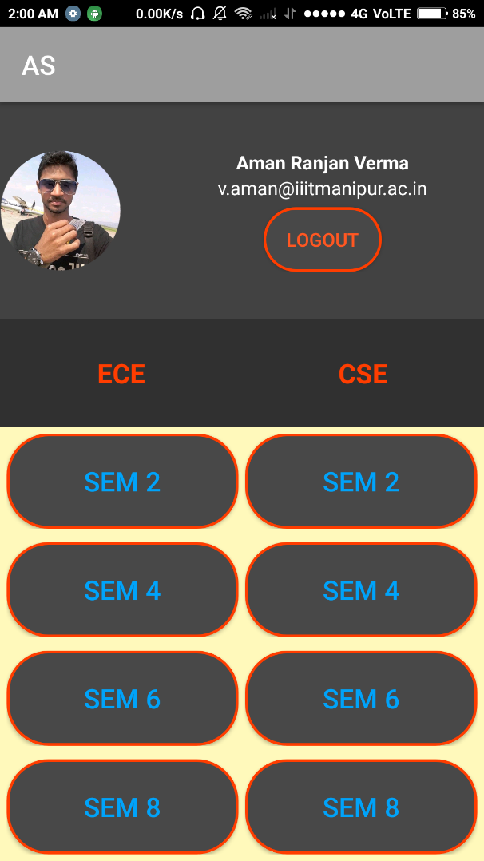
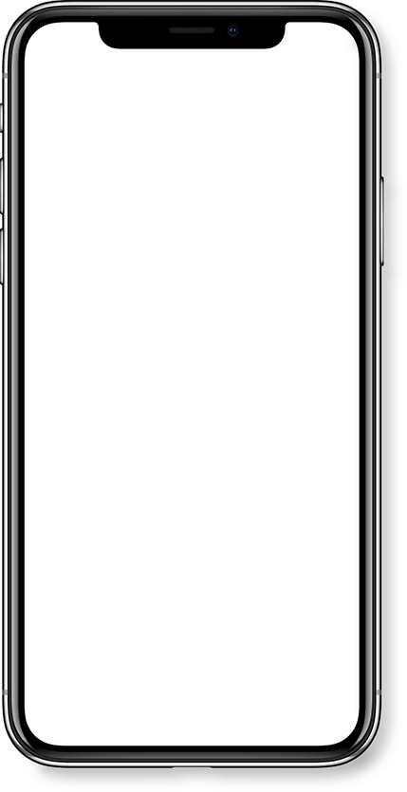

Android App
Attendance System

Slide 19
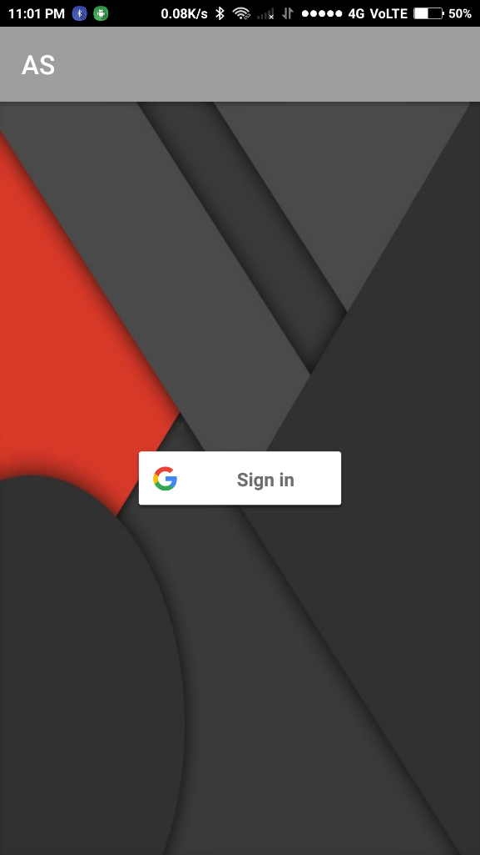
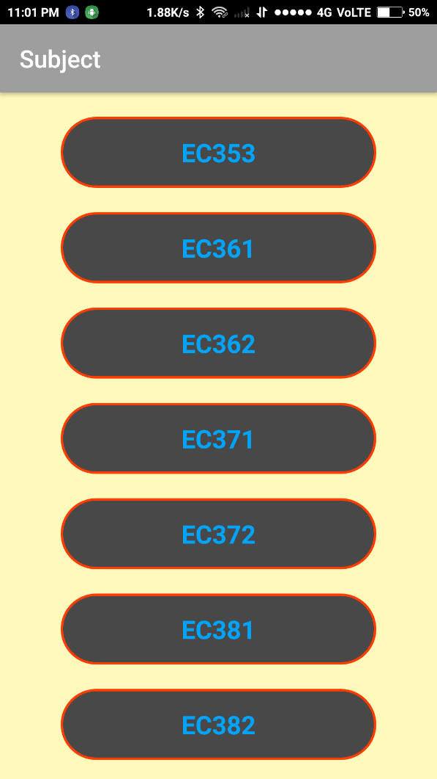
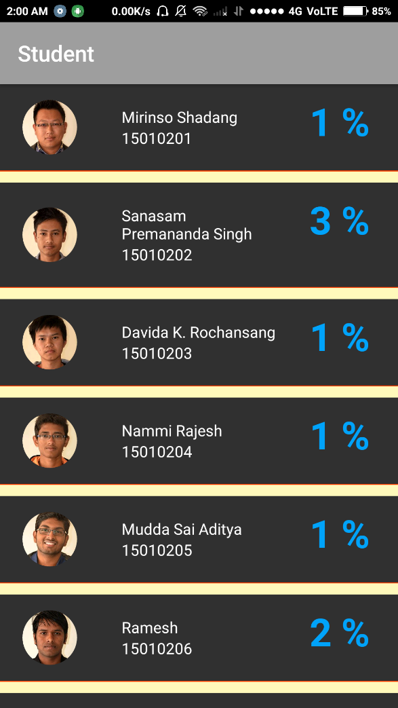
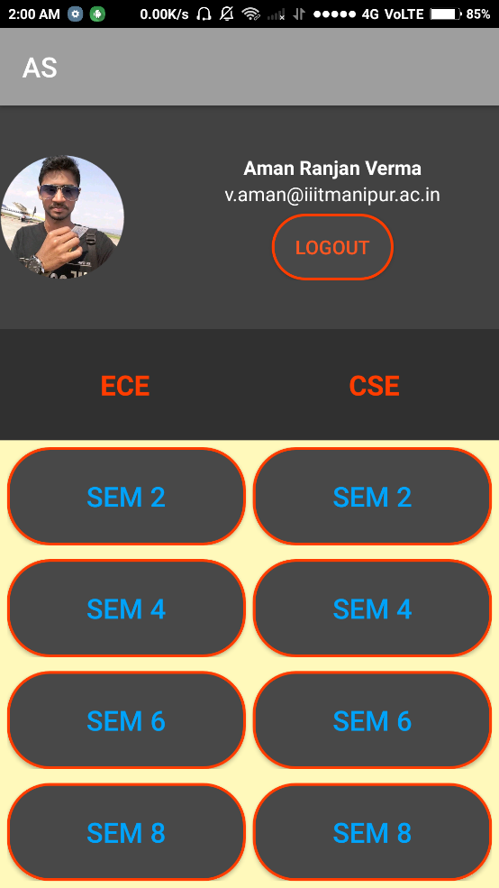
Attendance System App
Structure
Layout
Views
Programmed using XML
Working
Functionality
Programmed using Java

Slide 20

Attendance System App
Structure
Layout
Views
Programmed using XML
Working
Functionality
Programmed using Java
Image View
Text View
Button View

Slide 21

Attendance System App
Structure
Layout
Views
Programmed using XML
Working
Functionality
Programmed using Java

Slide 22
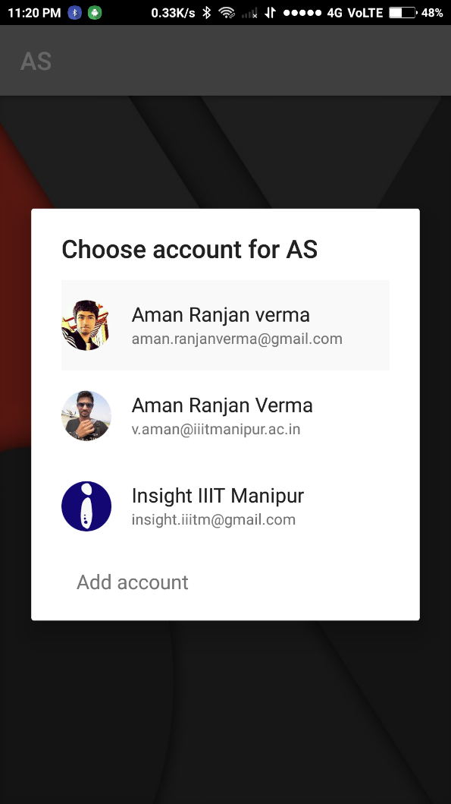
Attendance System App
Structure
Layout
Views
Programmed using XML
Working
Functionality
Programmed using Java

Slide 23
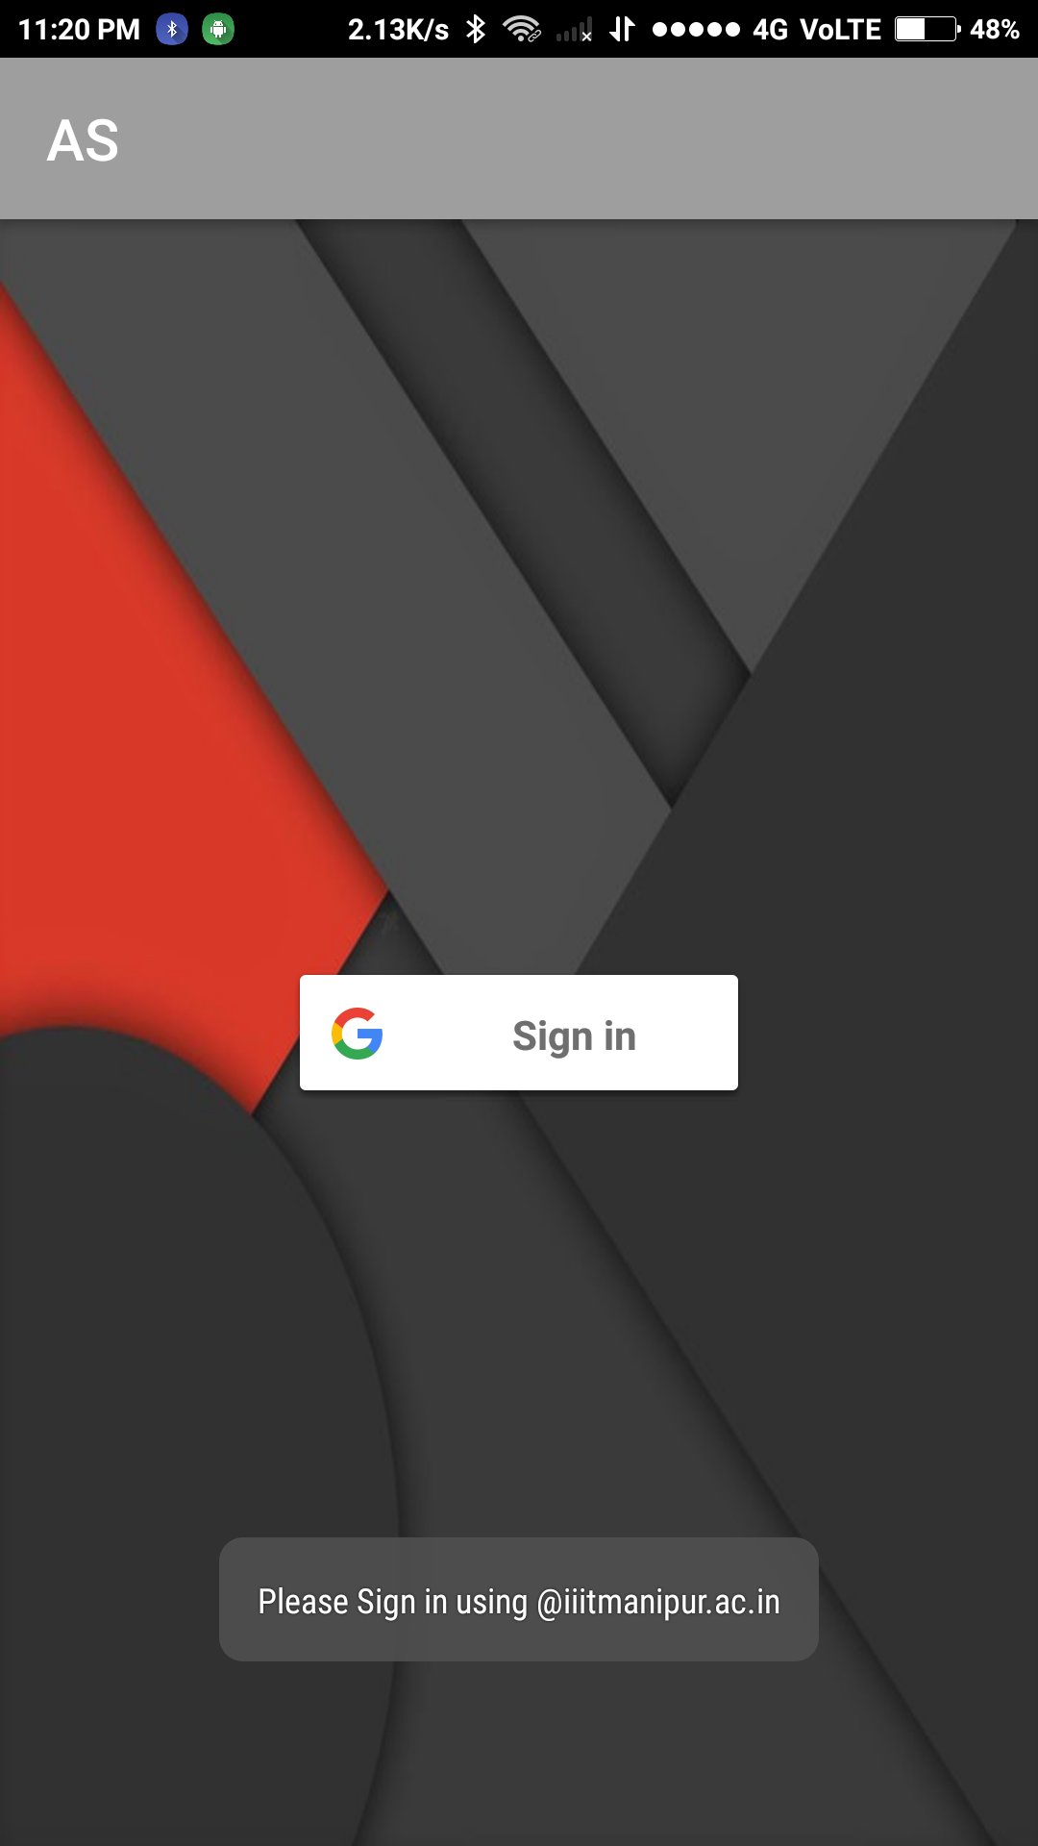

Attendance System App
Structure
Layout
Views
Programmed using XML
Working
Functionality
Programmed using Java

Slide 24
Attendance System App
Structure
Layout
Views
Programmed using XML
Working
Functionality
Programmed using Java

Slide 25
Attendance System App
Structure
Layout
Views
Programmed using XML
Working
Functionality
Programmed using Java

Slide 26
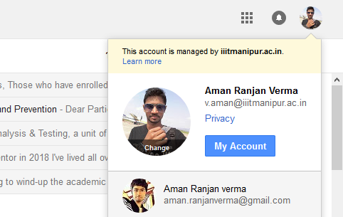
Attendance System App
Working
Functionality
Programmed using Java
Gmail

Slide 27
Attendance System App
Structure
Layout
Views
Programmed using XML
Working
Functionality
Programmed using Java

Slide 28

Attendance System App
Structure
Layout
Views
Programmed using XML
Working
Functionality
Programmed using Java

Slide 29

Flow of Data from Arduino to App

Slide 30


Flow of Data from Arduino to App cont..

Slide 31
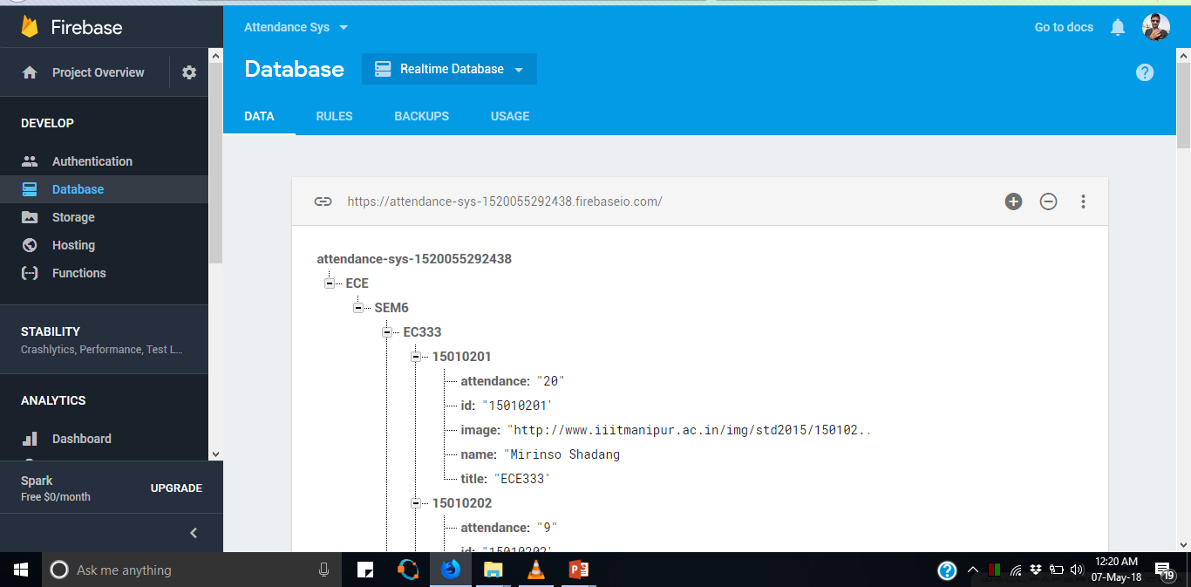
Firebase Security

Slide 32
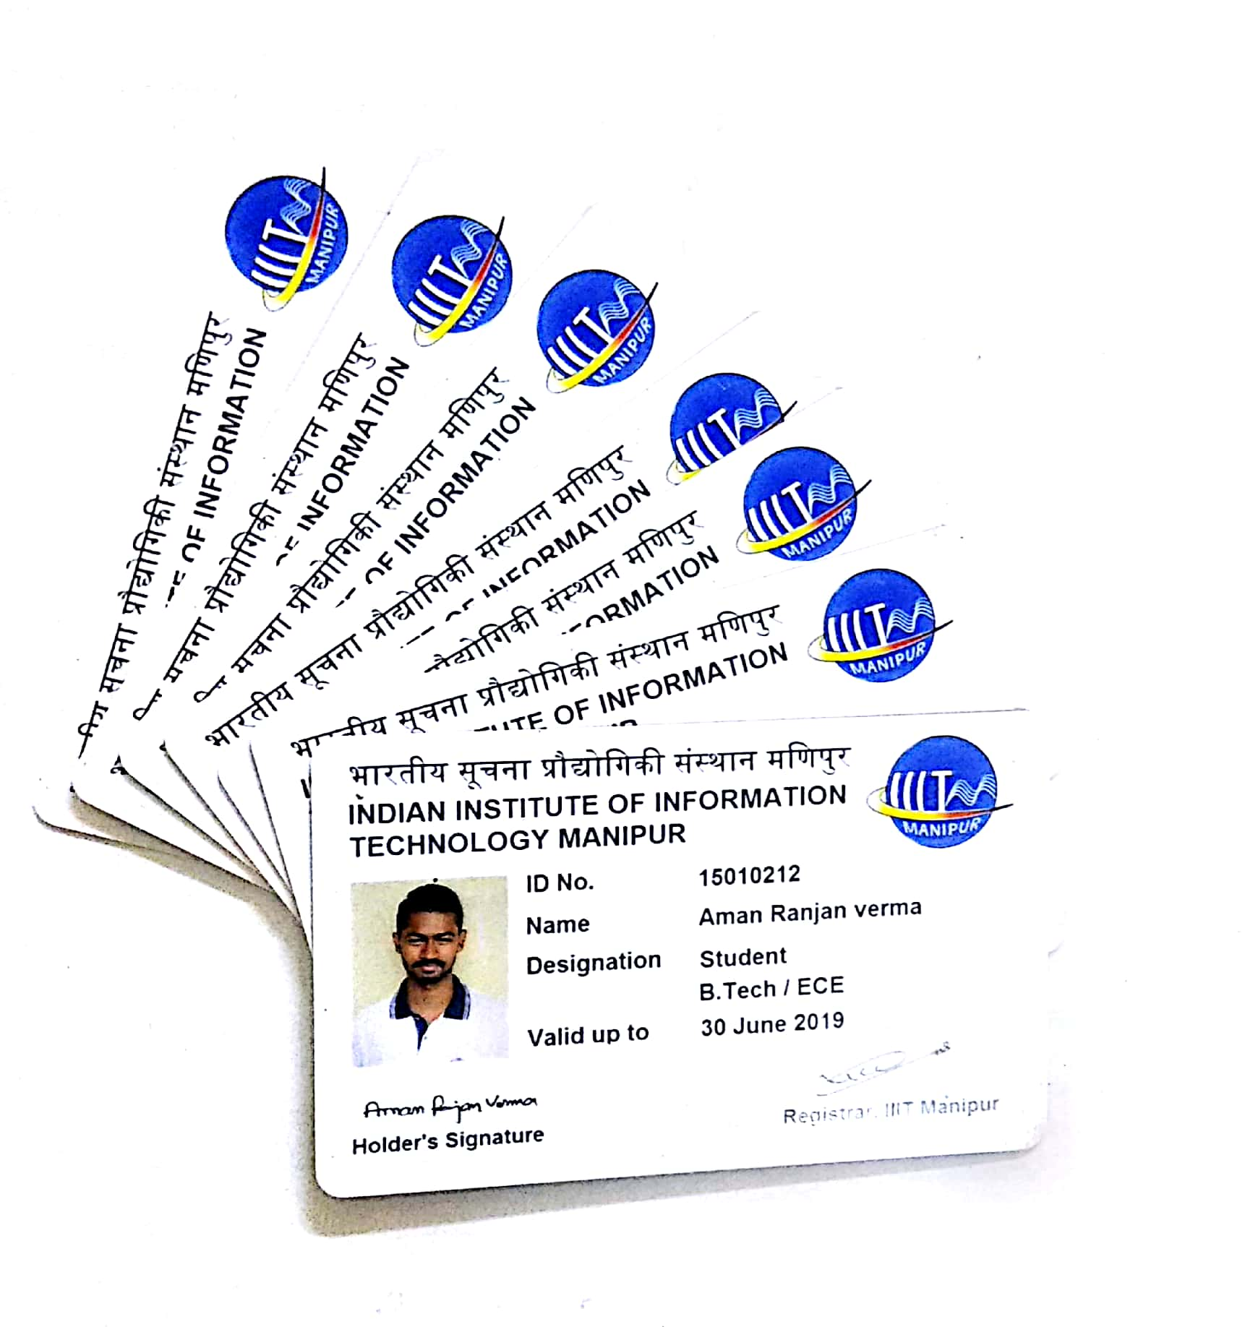
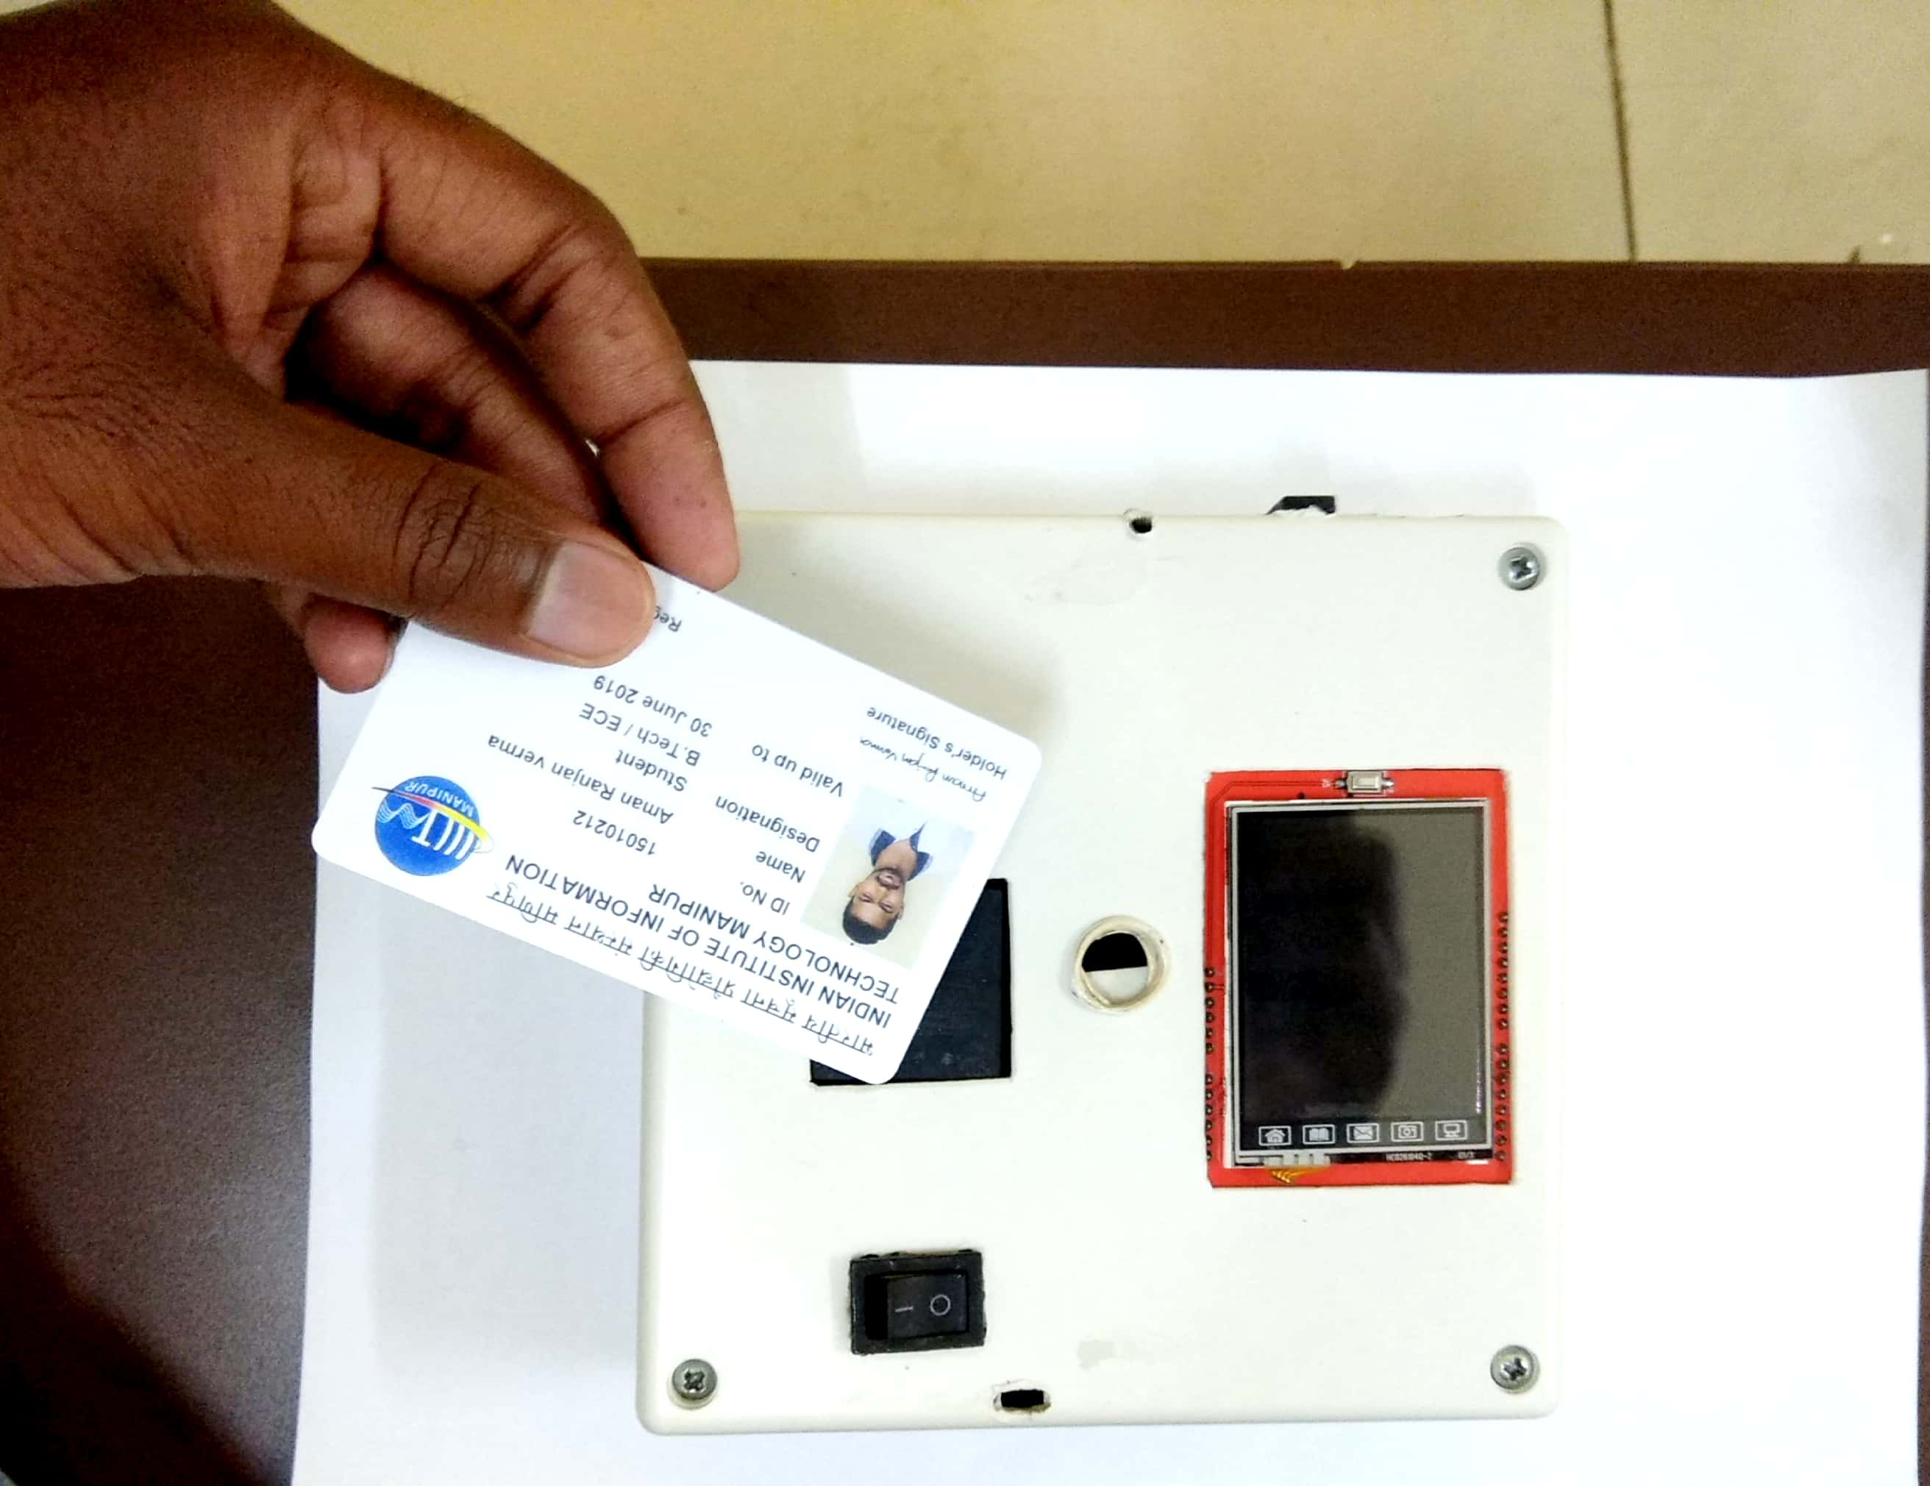
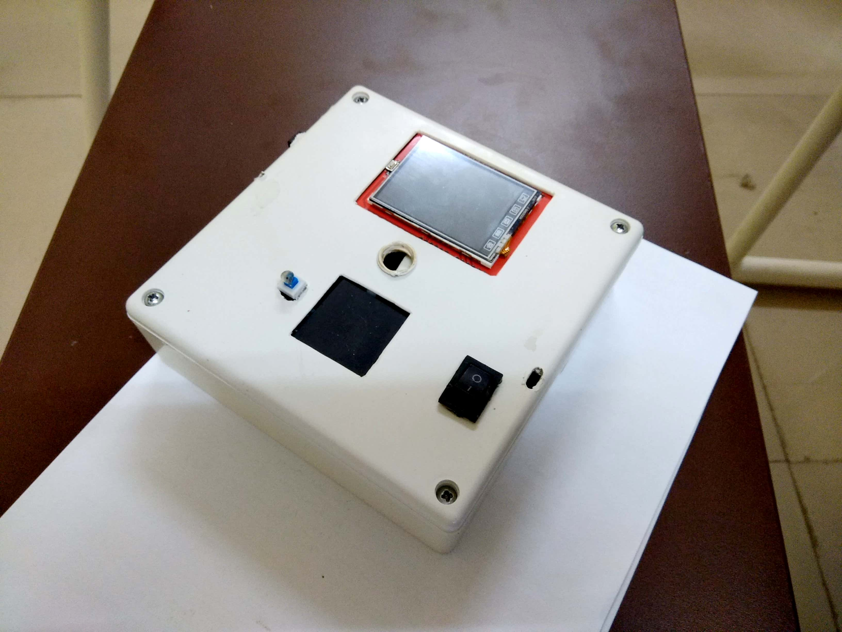
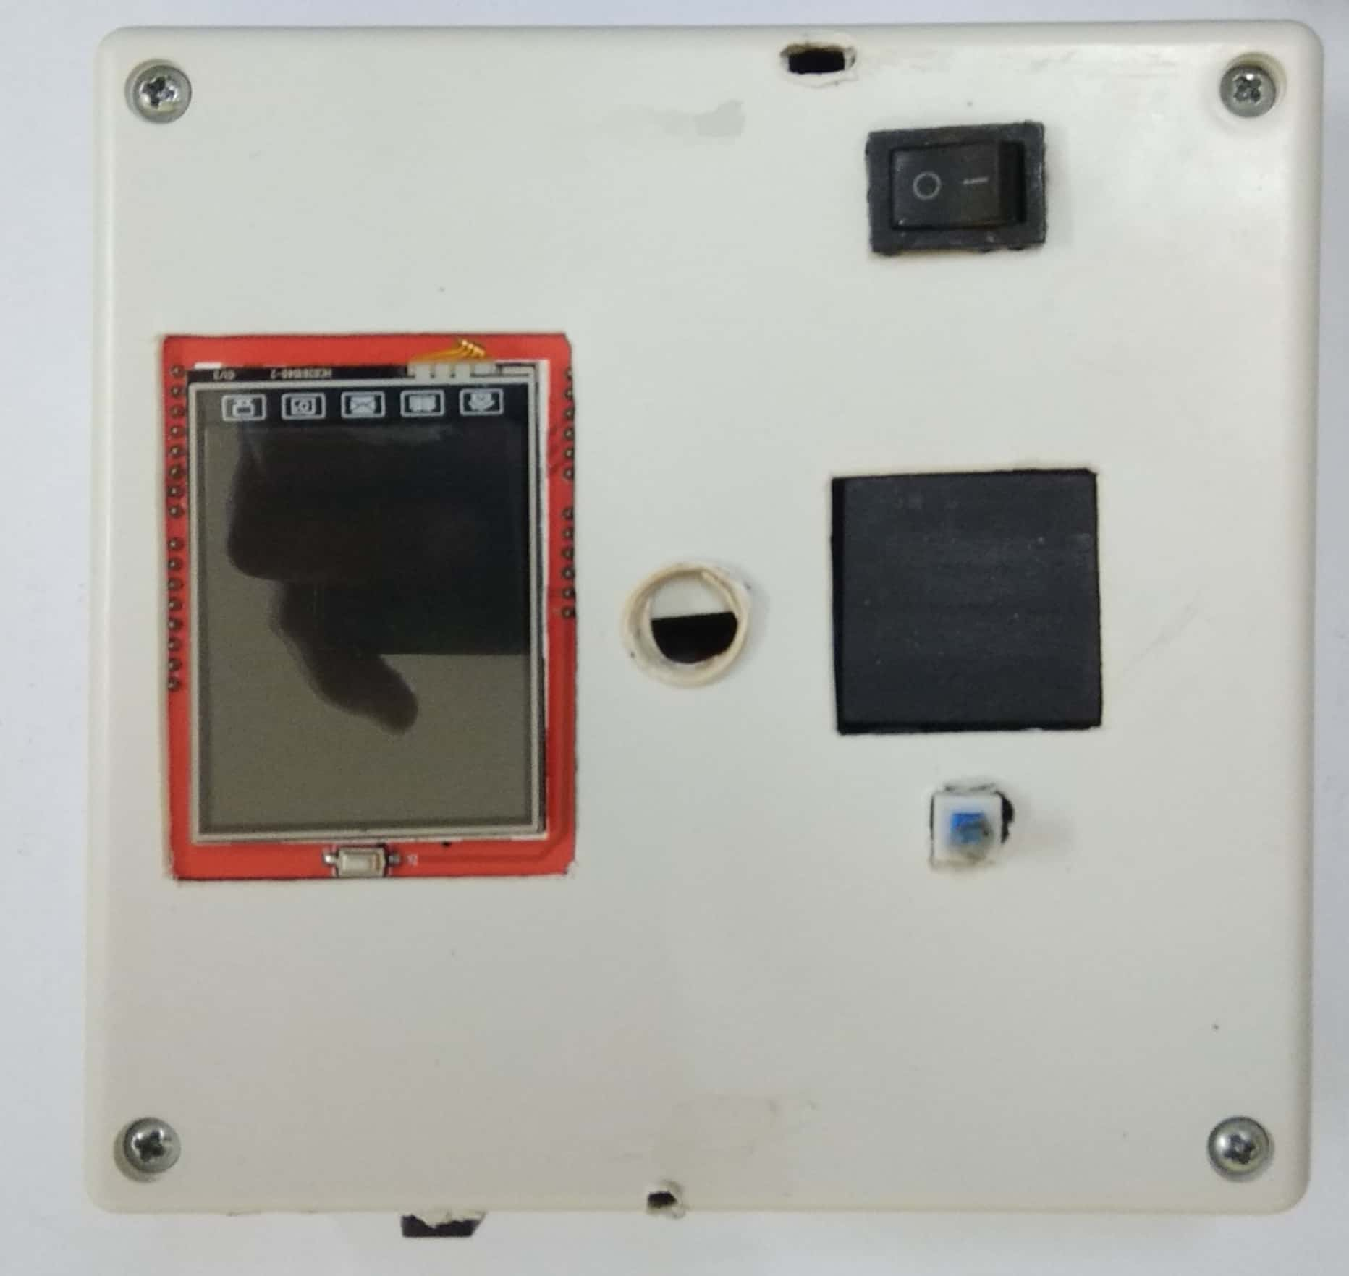
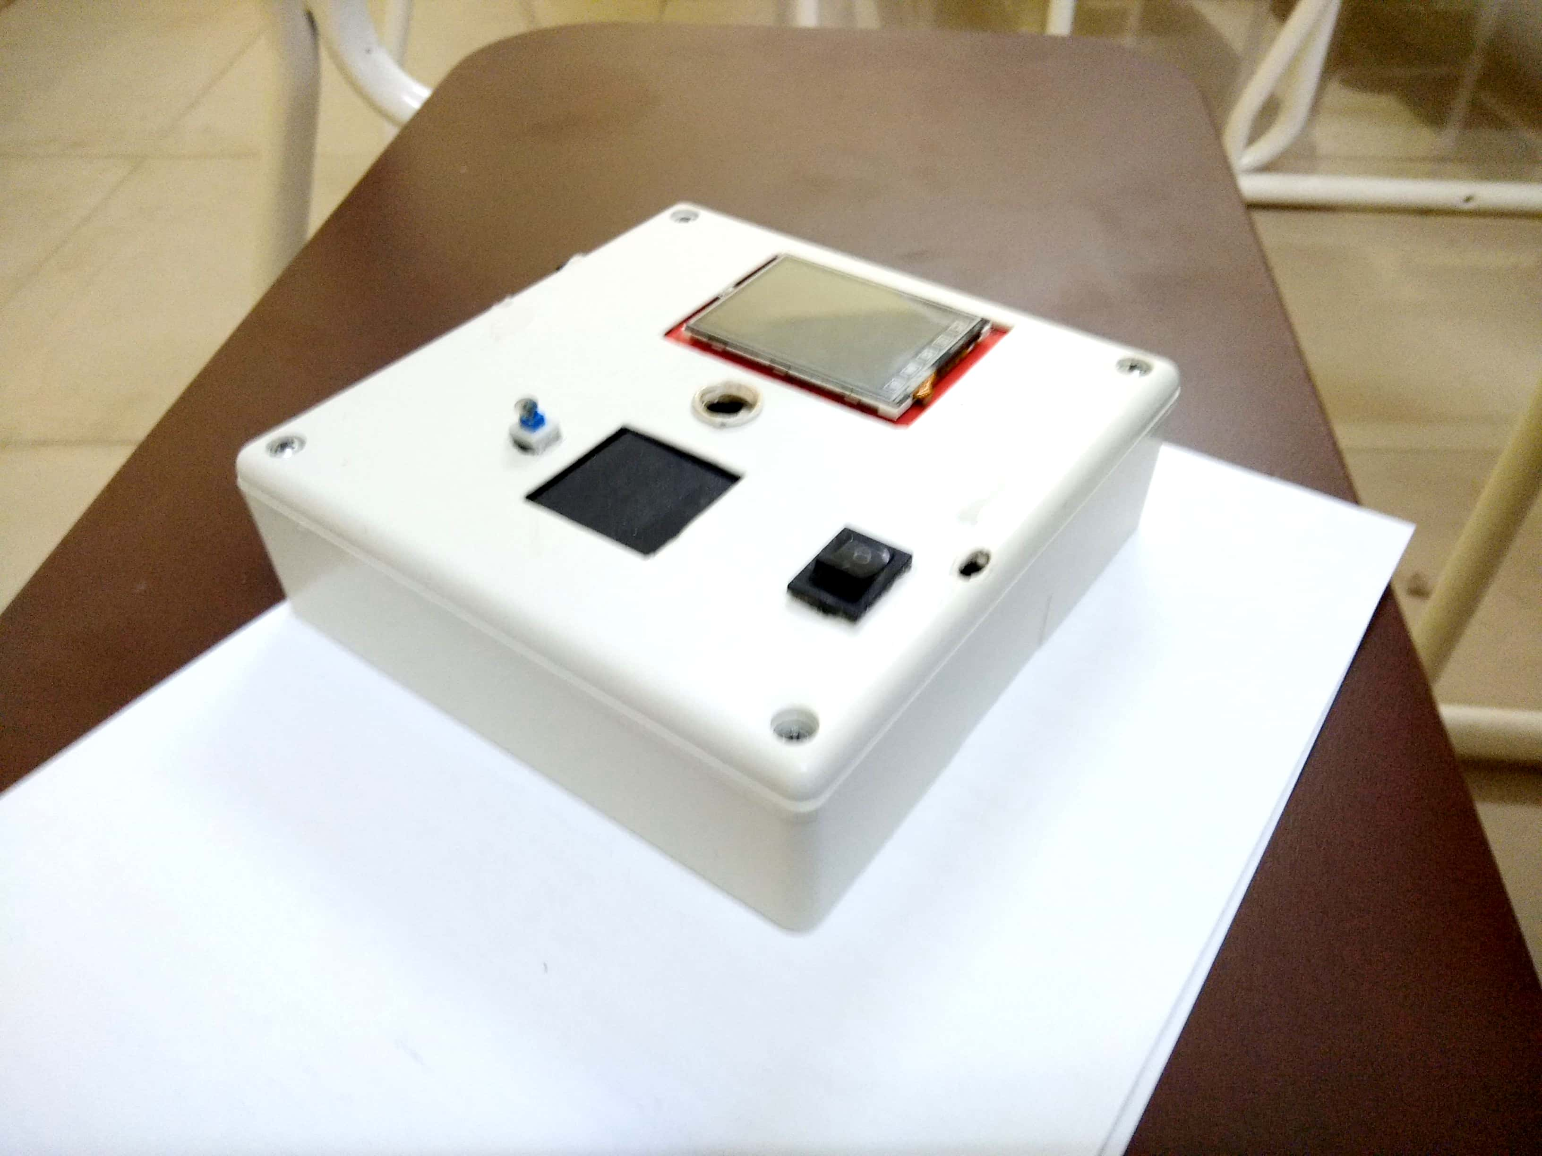
Project
Let’s move for demonstration.

Slide 33

Thank You

